Slide 1



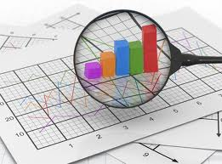
Multiple Linear Regression
Regression Analysis
Business Analytics
Graduate Studies

Slide 2
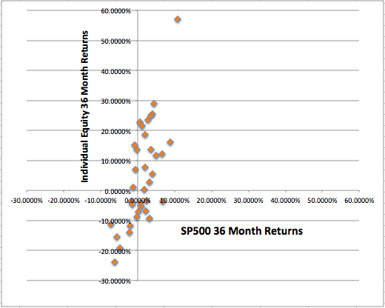
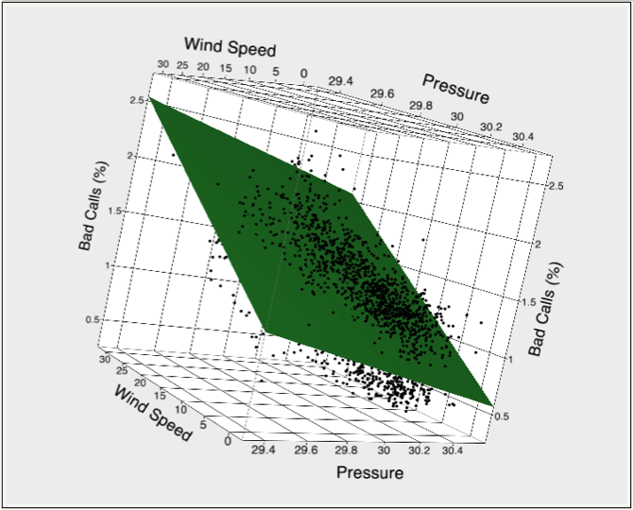

Multiple Linear Regression
Regression Analysis
Slope
STX
Business Analytics
Graduate Studies

Slide 3
Multiple Regression, Topics
Overview
Variance in Regression Analysis
Performance
Assumptions
Home Market Value Example Applications
- Home Market Value 3
- Home Market Value 4

Slide 4
Overview
Tool for building statistical models that characterize relationships among a dependent variable and one or more independent variables.
Prediction / Estimation, predict the value of an outcome variable based on multiple input variables.
Explanation, study the relationships between predictors and an outcome variable of interest.
Used when the outcome variable of interest is continuous.

Slide 5


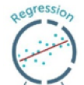

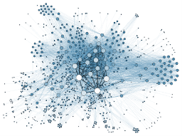
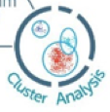
Overview
Supervised Learning
Data Mining
Unsupervised Learning

Slide 6






Overview
Predicting one thing
(that is continuous or an amount)
from one or many other things

Slide 7
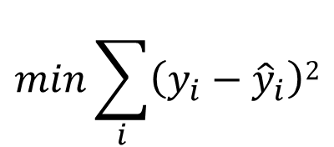
Overview
Constructs a linear (in the coefficients) combination of variables and coefficients such that the sum of squared errors of prediction are minimized.
$$min\sum_{i}{\left(y_{i}−{\hat{y}}_{i}\right)2}$$
Finding the coefficients (b₀, b₁, b₂, …) that minimize the sum of the squared errors, and provides the best fit line, plane, hyperplane.

Slide 8
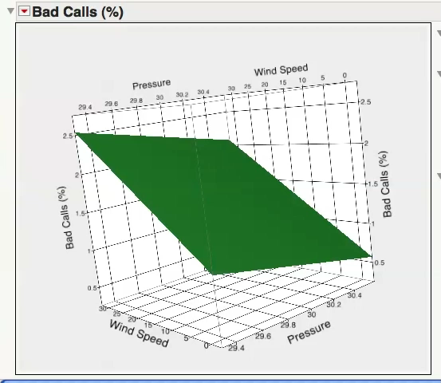
Overview

Slide 9
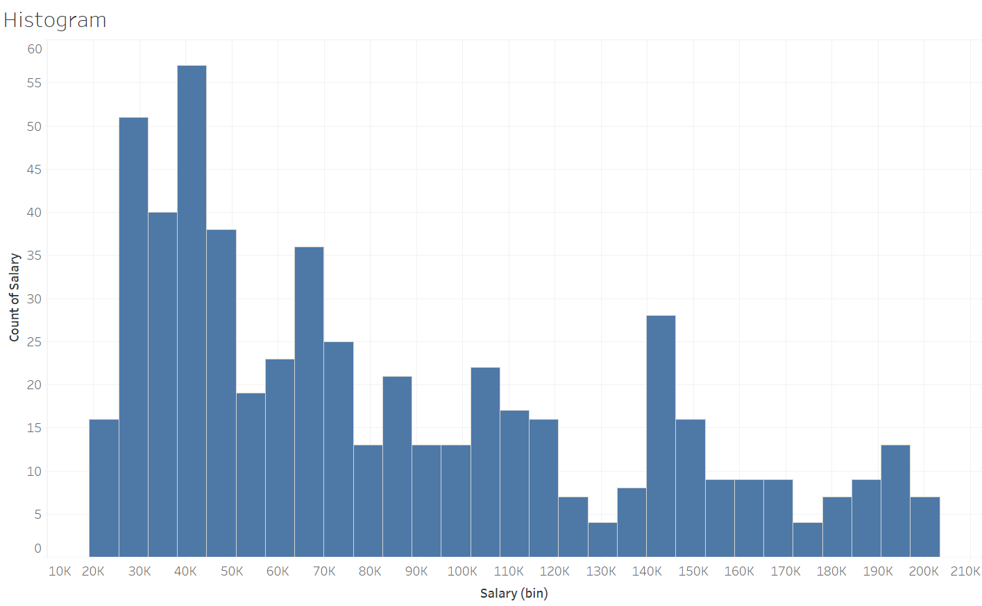
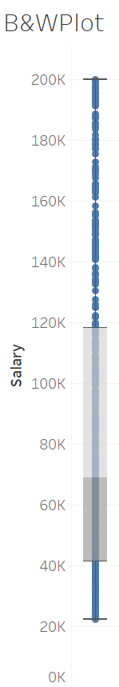
Variance
Y
variance in Y
Salaries Field/Attribute

Slide 10
Variance
Y
variance in Y

Slide 11
Variance
x₁
variance in x₁

Slide 12
Variance
x₂
variance in x₂

Slide 13

Variance

Slide 14


Variance

Slide 15
Variance
R² metric, the amount (percentage) of variance in Y explained by x₁ and x₂

Slide 16
Variance
unexplained or residual variance

Slide 17
Multicollinearity

Slide 18
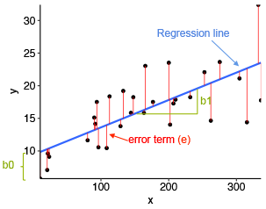
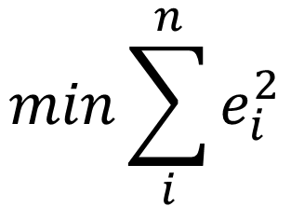
Performance
In most any Business Analytic techniques, the methodology/model tries to minimize the total error (difference between the model prediction and the actual value). Model parameters are “tweaked” until this total is minimized.
$$min\sum_{i}^{n}{e_{i}^{2}}$$

Slide 19

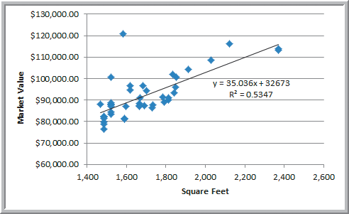
Assumptions
Outcome variable is continuous.
Linearity, each predictor with the outcome variable.
Independence, of errors.
Normality, of errors.
Equal variance, in the errors.

Slide 20
Building Good Regression Models
We prefer simpler models, when possible. This is the idea of parsimony, models with fewer parameters. More parameters than necessary introduces uncertainty and complexity. Adjusted R² to some extent measures the parsimony of the model.

Slide 21
Multiple Regression, Applications
Using All the Instances
Equity Beta
Home Market Value 3
- Value/Target and categorical predictors
Home Market Value 4 ➔ Value/Target
Toyota Corollas ➔ Price
Data Mining Approach (Split)

Slide 22

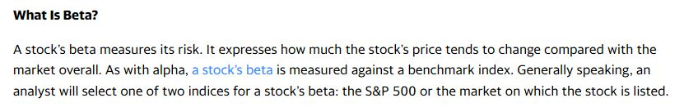
Estimating the Beta of an Equity
https://finance.yahoo.com/news/alpha-vs-beta-guide-investors-164757714.html
Slope
STX

Slide 23
Estimating the Beta of an Equity
Slope, Yes!

Slide 24
Estimating the Beta of an Equity
This is the Correlation!

Slide 25
Estimating the Beta of an Equity
This is the Correlation!

Slide 26

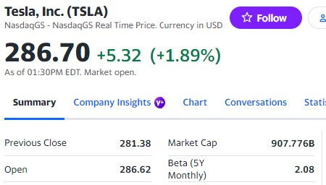
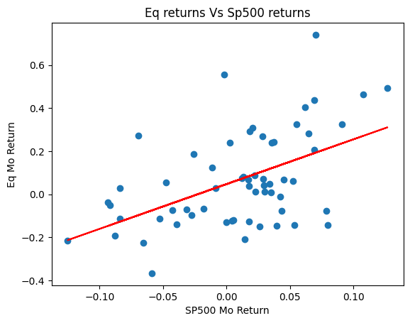
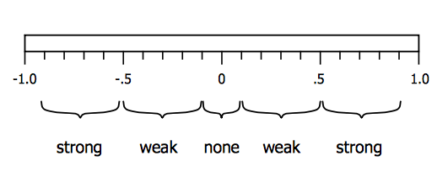


Estimating the Beta of an Equity
July 2023
r, correlation (not the slope), 0.51
Slope: 2.08
Correlation: 0.51

Slide 27

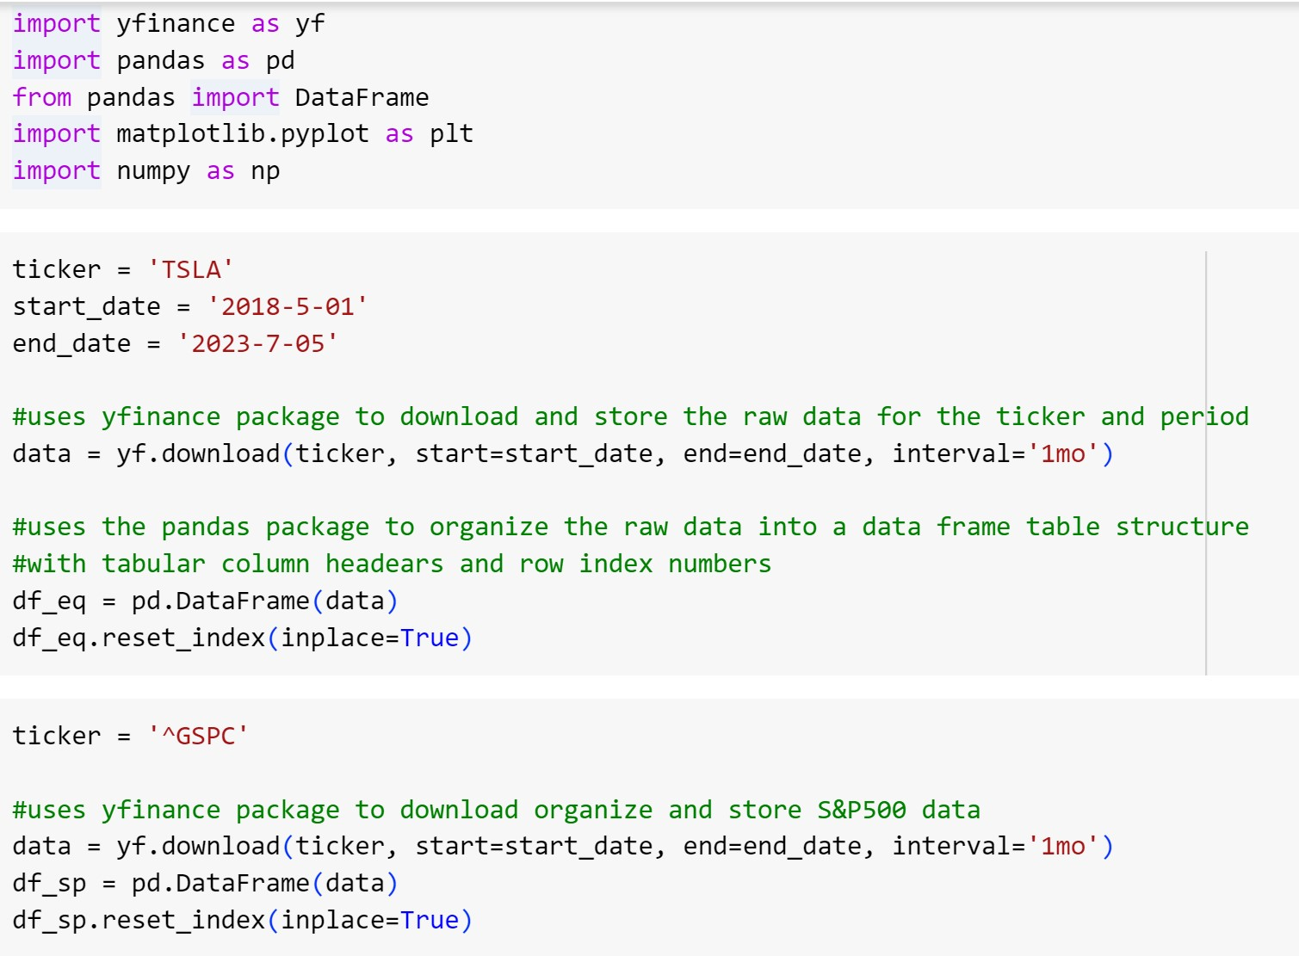
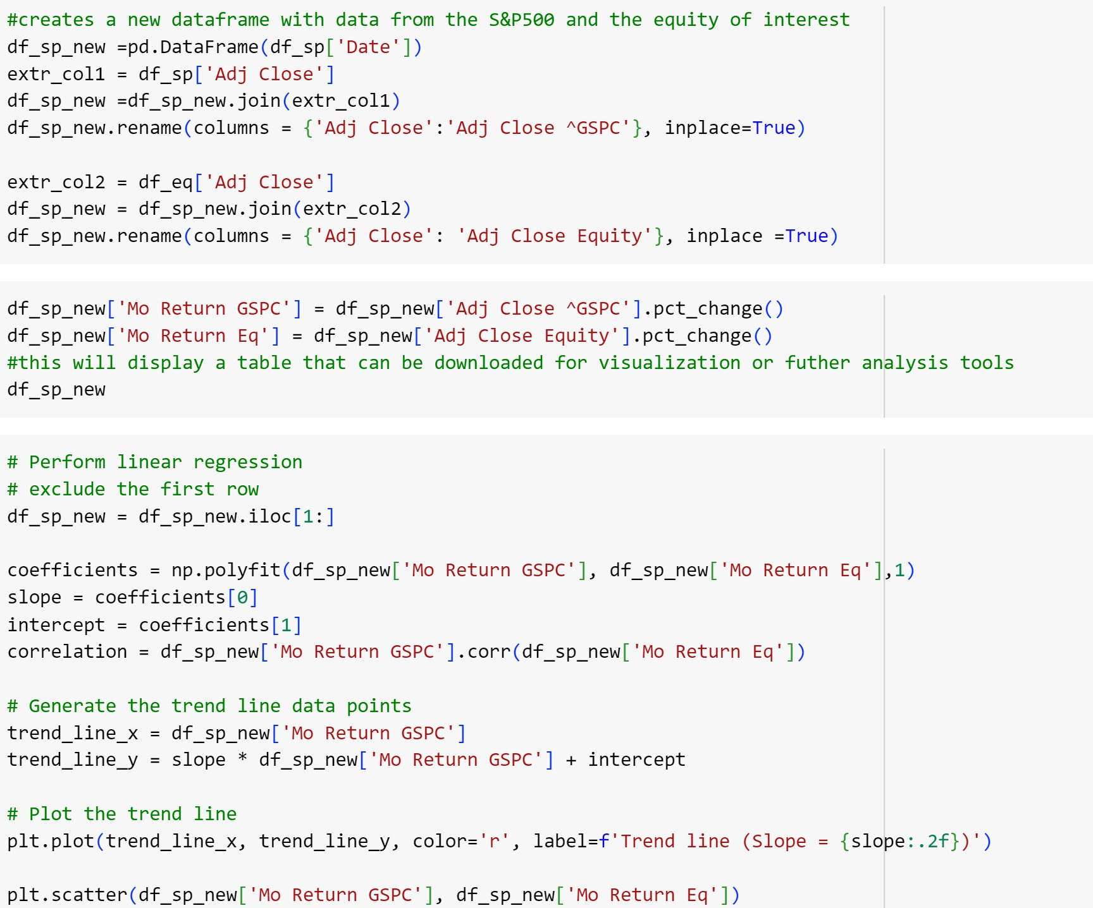
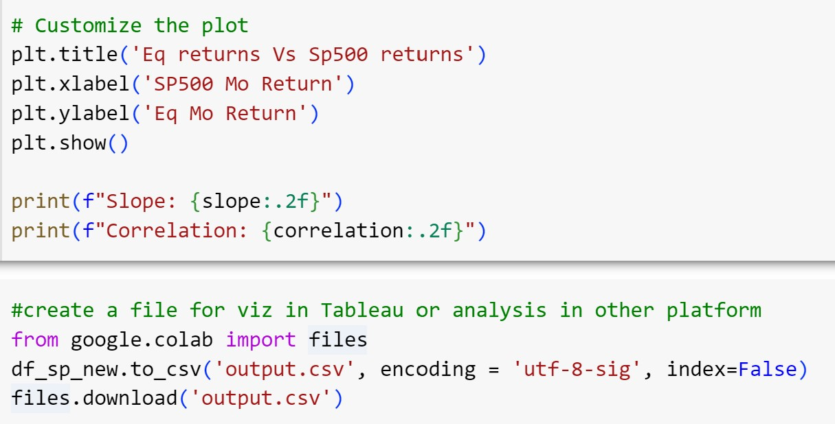

Estimating the Beta of an Equity
Google Colab
https://colab.research.google.com/drive/17p8dHcbFiINiQbzGYhB1ewGuNuaiYcjF?usp=sharing

Slide 28
Mini Workshop
Perform a simple linear regression analysis to obtain the Beta for the equity Apple, AAPL.
Determine r and b₁. Explain these two metrics and the difference between the two thoroughly.

Slide 29
Dummy / Indicator Variables Home Market Value 3

Slide 30
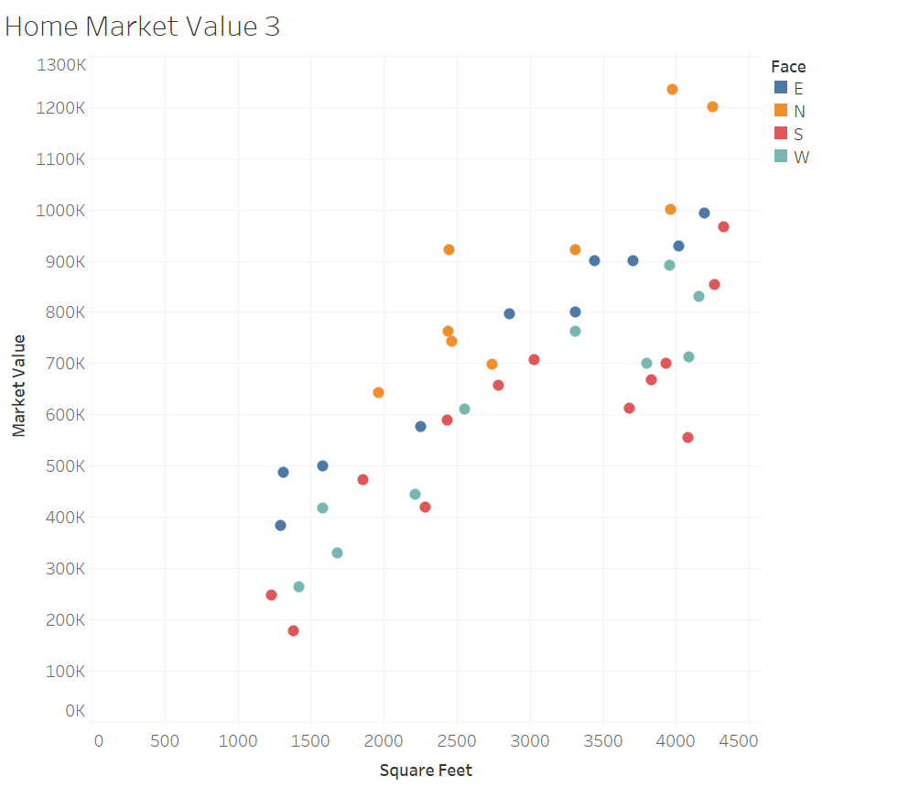
Dummy / Indicator Variables

Slide 31
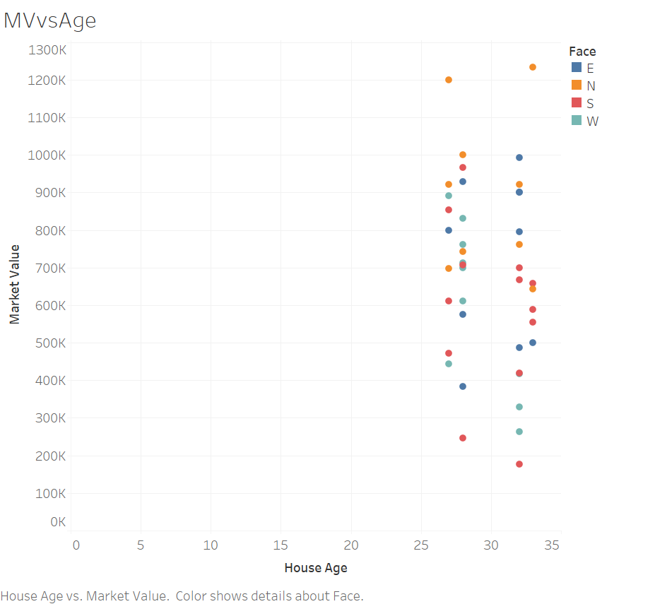
Dummy / Indicator Variables

Slide 32
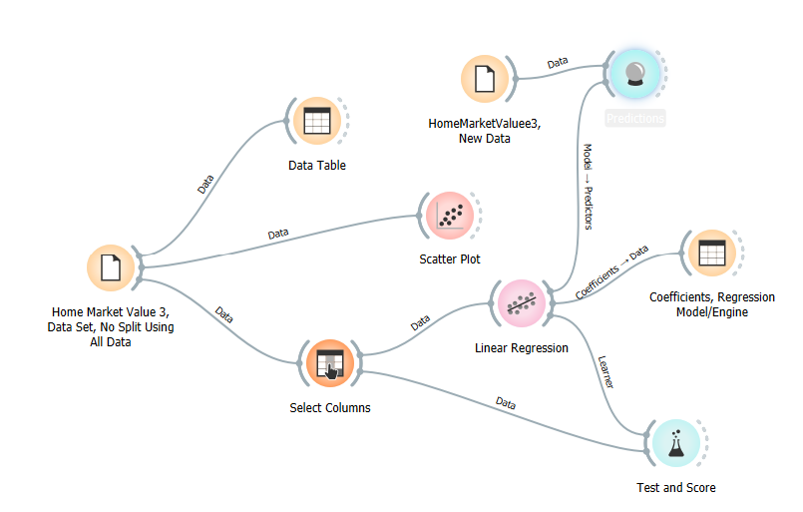
Orange Workflow

Slide 33
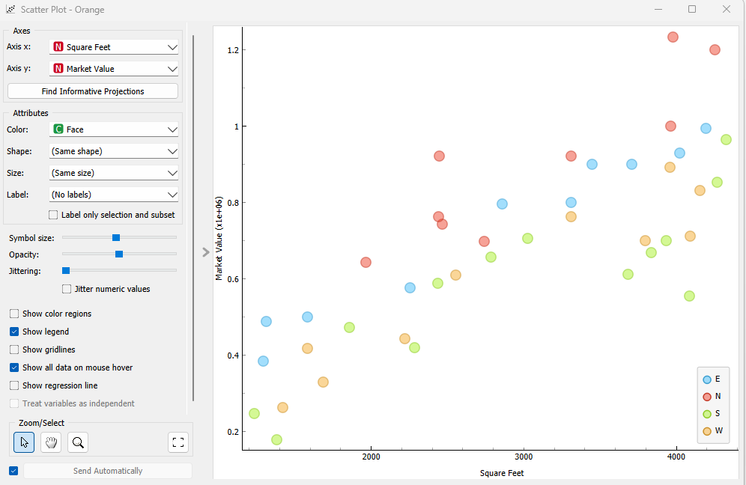
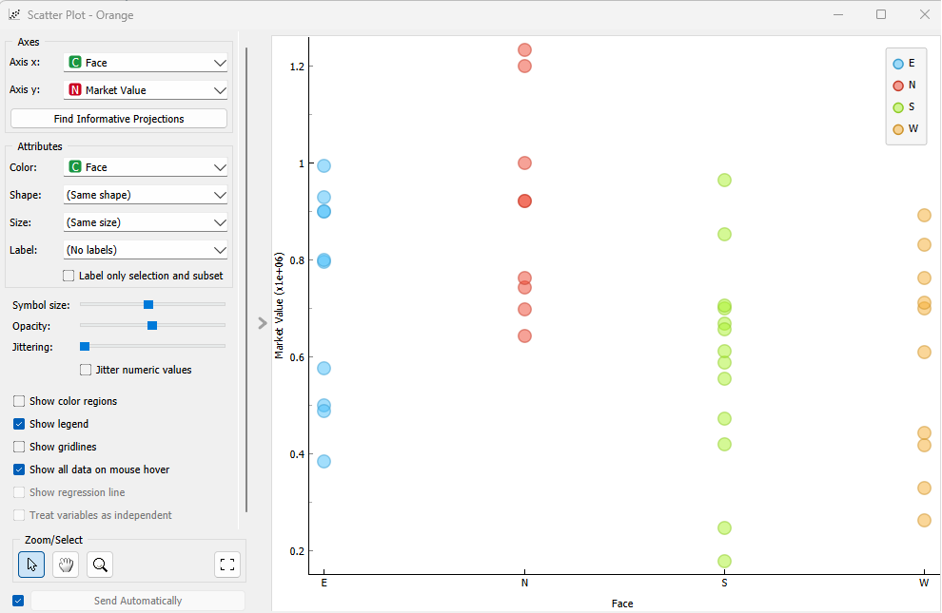
Orange Workflow

Slide 34
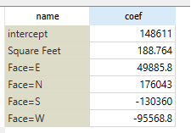
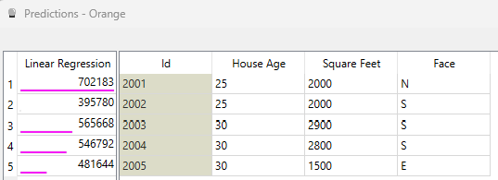
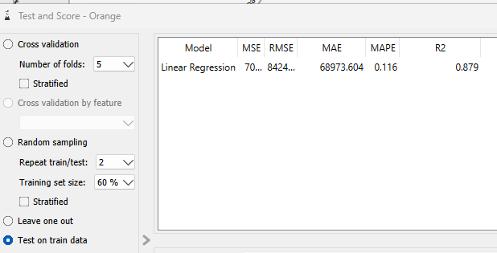
Orange Workflow Results
$\hat{Y}=148,611+188.8x_{1}+49,886x_{2}+1176,043x_{3}−130,360x_{4}−95,569$ $x_{5}$

Slide 35
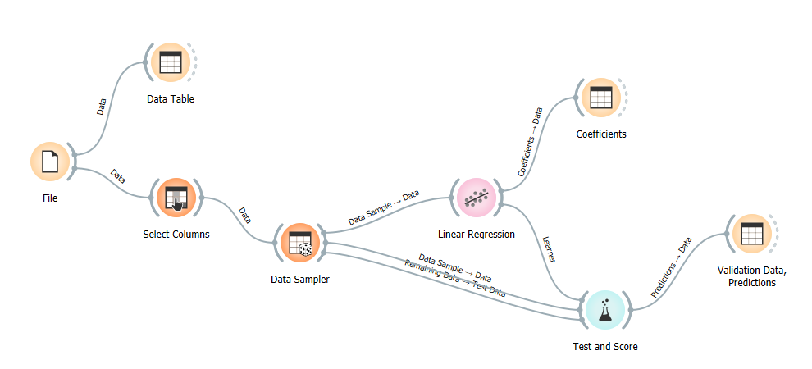
Home Market Value 4
Model Performance Evaluation Training Data, MAE, R² metrics

